Slide 1
Lab 2: Inverting and Noninverting OP-Amp Circuits
EE316-08 Spring 2021

Slide 2
Purpose: The goal of this laboratory is to examine inverting and noninverting Op-Amp configurations for both DC and AC inputs.

Slide 3
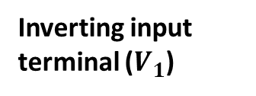
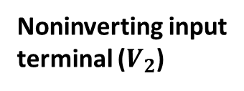
Operational Amplifier (Op-amp)
A typical op-amp consists of an inverting input, a noninverting input, two dc power supply leads (positive and negative), and the output.
Generally, dc power supply leads are not included in circuit schematics, but we assume that they are being used.
Positive Supply Voltage (+Vs)
Inverting input
terminal ($V_{1}$)
-
Output
Noninverting input
terminal ($V_{2}$)
+
Negative Supply Voltage (-Vs)

Slide 4
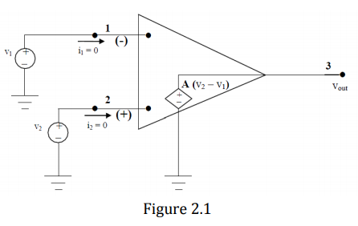

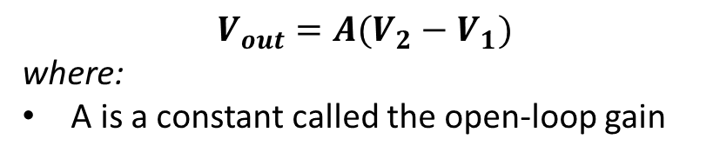
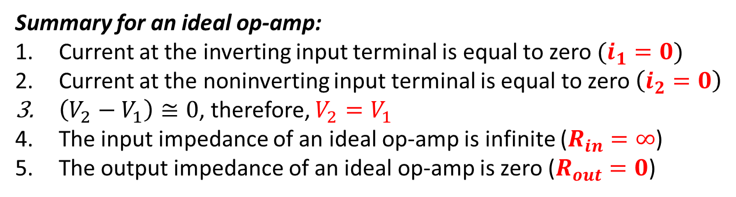




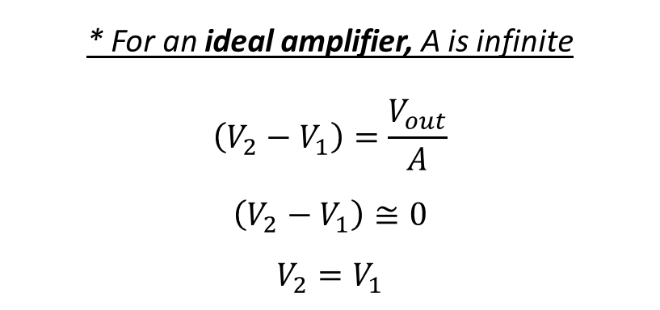

‘Ideal’ Operational Amplifier
The inverting input terminal
$$V_{out}=A(V_{2}−V_{1})$$
where:
A is a constant called the open-loop gain
$$V_{1}$$
$$R_{out}=0$$
* For an ideal amplifier, A is infinite
$$\left(V_{2}−V_{1}\right)=\frac{V_{out}}{A}$$
$$\left(V_{2}−V_{1}\right)≅0$$
$$V_{2}=V_{1}$$
$$i_{1}=0$$
$$R_{in}=∞$$
$$V_{2}$$
$$i_{2}=0$$
Summary for an ideal op-amp:
Current at the inverting input terminal is equal to zero $(i_{1}=0)$
Current at the noninverting input terminal is equal to zero$\left(i_{2}=0\right)$
$\left(V_{2}−V_{1}\right)≅0$, therefore, $V_{2}=V_{1}$
The input impedance of an ideal op-amp is infinite ($R_{in}=∞$)
The output impedance of an ideal op-amp is zero ($R_{out}=0$)
The noninverting input terminal

Slide 5
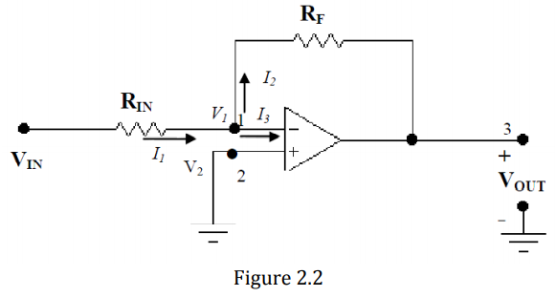
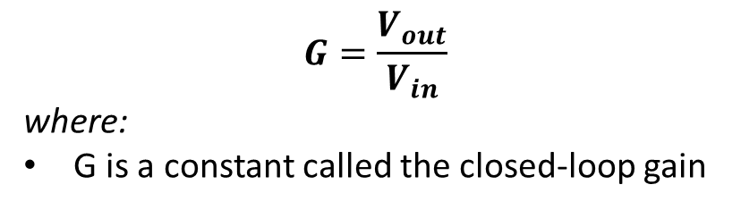

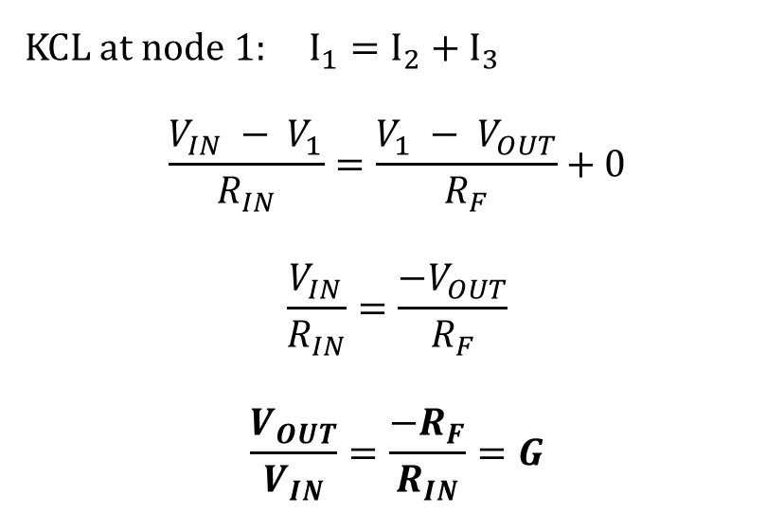


Inverting Amplifier
The inverting input terminal
$$V_{2}=V_{1}=0$$
$$G=\frac{V_{out}}{V_{in}}$$
where:
G is a constant called the closed-loop gain
KCL at node 1: $I_{1}=I_{2}+I_{3}$
$$\frac{V_{IN} − V_{1}}{R_{IN}}=\frac{V_{1} − V_{OUT}}{R_{F}}+0$$
$$\frac{V_{IN}}{R_{IN}}=\frac{−V_{OUT}}{R_{F}}$$
$$\frac{V_{OUT}}{V_{IN}}=\frac{−R_{F}}{R_{IN}}=G$$
$$I_{4}$$
The noninverting input terminal
Summary for an ideal op-amp:
Current at the inverting input terminal is equal to zero $(I_{3}=0)$
Current at the noninverting input terminal is equal to zero$\left(I_{4}=0\right)$
$\left(V_{2}−V_{1}\right)≅0$, therefore, $V_{2}=V_{1}$
The input impedance of an ideal op-amp is infinite ($R_{in}=∞$)
The output impedance of an ideal op-amp is zero ($R_{out}=0$)

Slide 6
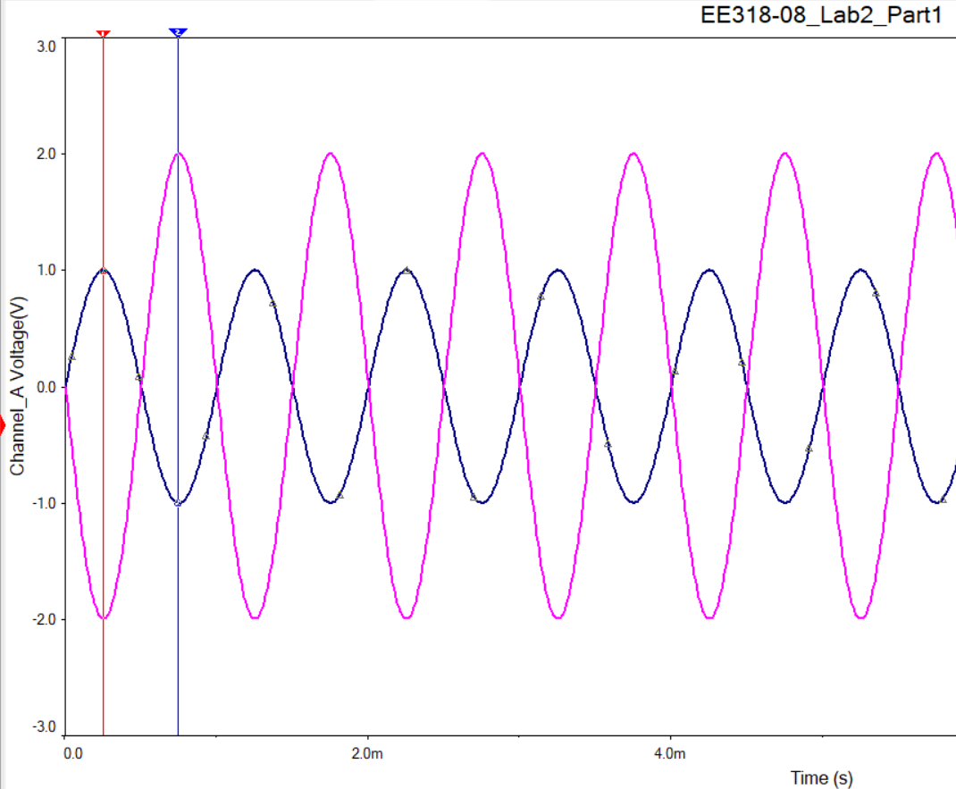
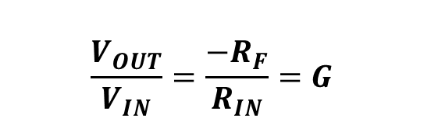
Inverting Amplifier
$$\frac{V_{OUT}}{V_{IN}}=\frac{−R_{F}}{R_{IN}}=G$$
$$V_{2}=V_{1}=0$$
Input Signal
$$I_{4}$$
Summary for an ideal op-amp:
Current at the inverting input terminal is equal to zero $(I_{3}=0)$
Current at the noninverting input terminal is equal to zero$\left(I_{4}=0\right)$
$\left(V_{2}−V_{1}\right)≅0$, therefore, $V_{2}=V_{1}$
The input impedance of an ideal op-amp is infinite ($R_{in}=∞$)
The output impedance of an ideal op-amp is zero ($R_{out}=0$)
Output Signal
* Output signal is completely out of phase with respect to the input signal. *

Slide 7
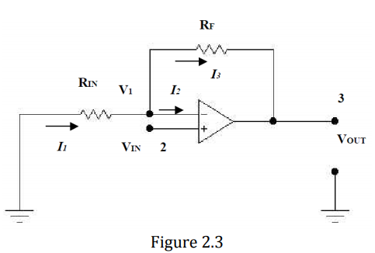

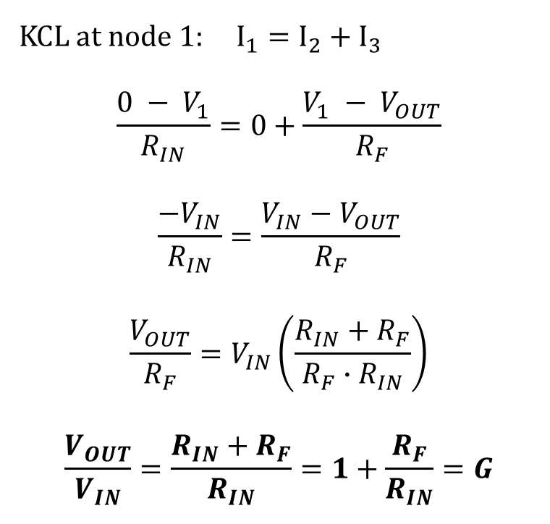



Non-Inverting Amplifier
$$V_{2}=V_{IN}=V_{1}$$
$$G=\frac{V_{out}}{V_{in}}$$
Recall,
KCL at node 1: $I_{1}=I_{2}+I_{3}$
$$\frac{0 − V_{1}}{R_{IN}}=0+\frac{V_{1} − V_{OUT}}{R_{F}}$$
$$\frac{{−V}_{IN}}{R_{IN}}=\frac{V_{IN}−V_{OUT}}{R_{F}}$$
$$\frac{V_{OUT}}{R_{F}}=V_{IN}\left(\frac{R_{IN}+R_{F}}{R_{F}∙R_{IN}}\right)$$
$$\frac{V_{OUT}}{V_{IN}}=\frac{R_{IN}+R_{F}}{R_{IN}}=1+\frac{R_{F}}{R_{IN}}=G$$
1
$$I_{4}$$
Summary for an ideal op-amp:
Current at the inverting input terminal is equal to zero $(I_{2}=0)$
Current at the noninverting input terminal is equal to zero$\left(I_{4}=0\right)$
$\left(V_{2}−V_{1}\right)≅0$, therefore, $V_{2}=V_{1}$
The input impedance of an ideal op-amp is infinite ($R_{in}=∞$)
The output impedance of an ideal op-amp is zero ($R_{out}=0$)

Slide 8
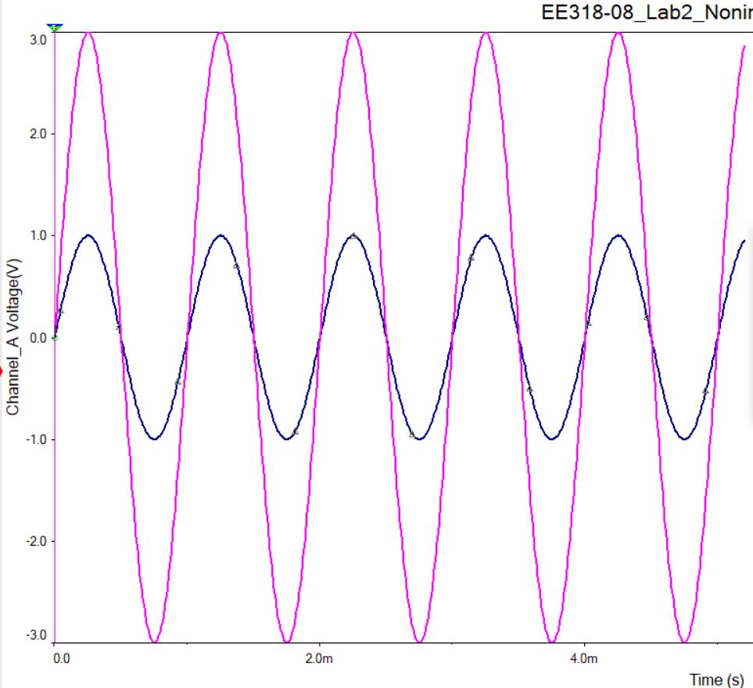

Non-Inverting Amplifier
$$\frac{V_{OUT}}{V_{IN}}=1+\frac{R_{F}}{R_{IN}}=G$$
$$V_{2}=V_{IN}=V_{1}$$
1
Input Signal
$$I_{4}$$
Summary for an ideal op-amp:
Current at the inverting input terminal is equal to zero $(I_{2}=0)$
Current at the noninverting input terminal is equal to zero$\left(I_{4}=0\right)$
$\left(V_{2}−V_{1}\right)≅0$, therefore, $V_{2}=V_{1}$
The input impedance of an ideal op-amp is infinite ($R_{in}=∞$)
The output impedance of an ideal op-amp is zero ($R_{out}=0$)
Output Signal
* Output signal is in phase with respect to input signal. *

Slide 9
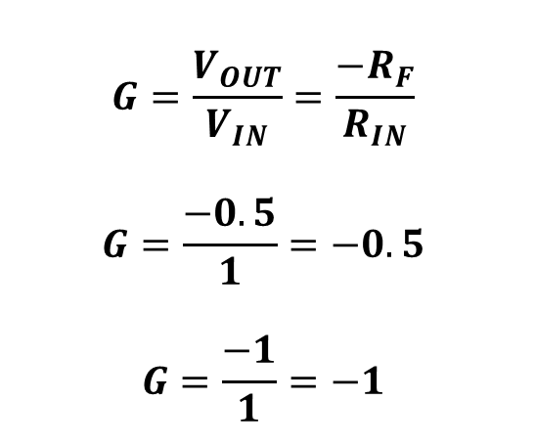
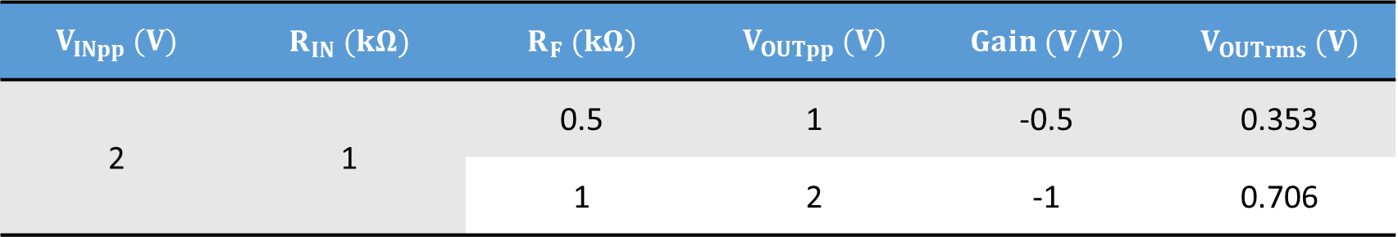
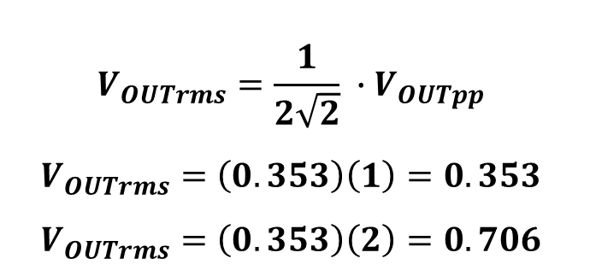
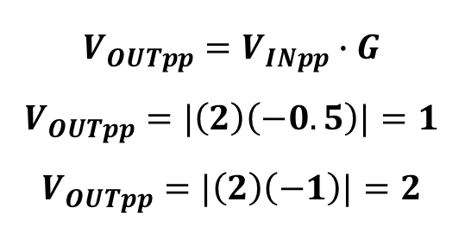
Calculations: Table 2.1 (Inverting Amplifier)
$$V_{INpp} (V)$$ | $$R_{IN} (kΩ)$$ | $$R_{F} (kΩ)$$ | $$V_{OUTpp} (V)$$ | $$Gain (V/V)$$ | $$V_{OUTrms} (V)$$
2 | 1 | 0.5 | 1 | -0.5 | 0.353
 |  | 1 | 2 | -1 | 0.706
Note: V peak to peak is the distance from the lowest negative amplitude to the highest positive amplitude of the AC signal.
$$G=\frac{V_{OUT}}{V_{IN}}=\frac{−R_{F}}{R_{IN}}$$
$$G=\frac{−0.5}{1}=−0.5$$
$$G=\frac{−1}{1}=−1$$
$$V_{OUTrms}=\frac{1}{2\sqrt{2}} ∙V_{OUTpp}$$
$$V_{OUTrms}=\left(0.353\right)\left(1\right)=0.353$$
$$V_{OUTrms}=\left(0.353\right)\left(2\right)=0.706$$
$$V_{OUTpp}=V_{INpp}∙G$$
$$V_{OUTpp}=|\left(2\right)\left(−0.5\right)|=1$$
$$V_{OUTpp}=|\left(2\right)\left(−1\right)|=2$$

Slide 10
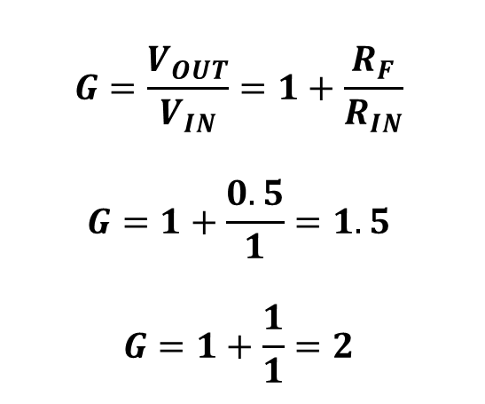
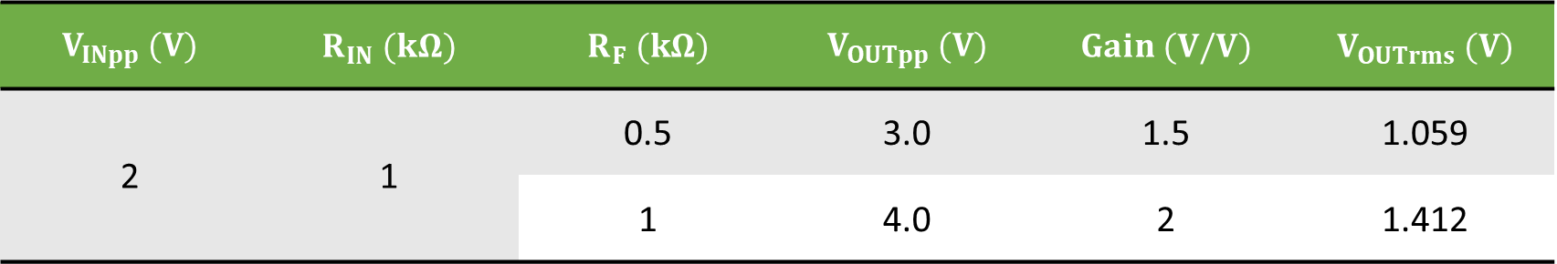
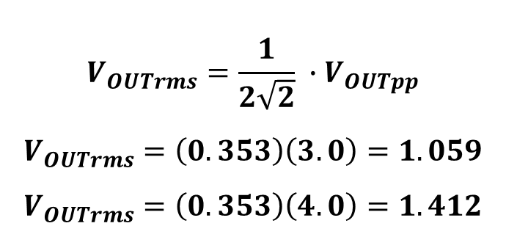
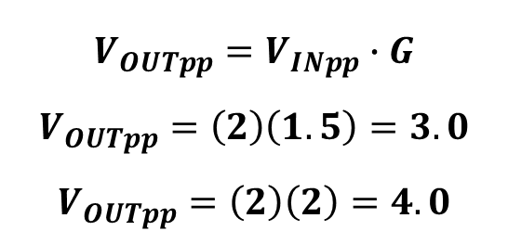
Calculations: Table 2.2 (Non-Inverting Amplifier)
$$V_{INpp} (V)$$ | $$R_{IN} (kΩ)$$ | $$R_{F} (kΩ)$$ | $$V_{OUTpp} (V)$$ | $$Gain (V/V)$$ | $$V_{OUTrms} (V)$$
2 | 1 | 0.5 | 3.0 | 1.5 | 1.059
 |  | 1 | 4.0 | 2 | 1.412
$$G=\frac{V_{OUT}}{V_{IN}}=1+\frac{R_{F}}{R_{IN}}$$
$$G=1+\frac{0.5}{1}=1.5$$
$$G=1+\frac{1}{1}=2$$
$$V_{OUTrms}=\frac{1}{2\sqrt{2}} ∙V_{OUTpp}$$
$$V_{OUTrms}=\left(0.353\right)\left(3.0\right)=1.059$$
$$V_{OUTrms}=\left(0.353\right)\left(4.0\right)=1.412$$
$$V_{OUTpp}=V_{INpp}∙G$$
$$V_{OUTpp}=\left(2\right)\left(1.5\right)=3.0$$
$$V_{OUTpp}=\left(2\right)\left(2\right)=4.0$$

Slide 11
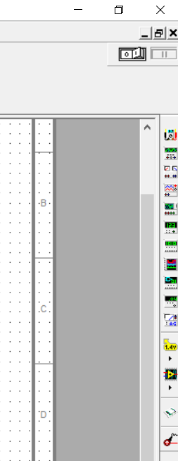
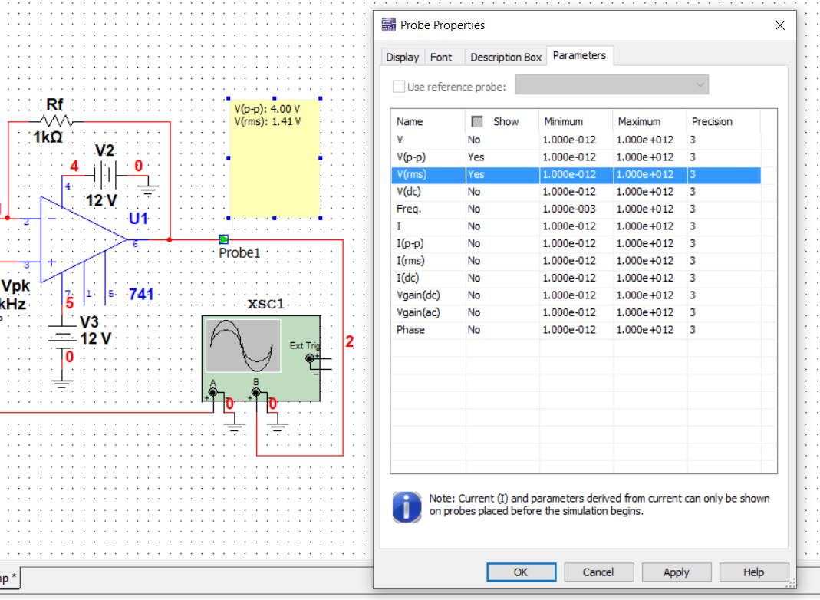

Multisim: Measure $V_{OUTpp}$ and $V_{OUTrms}$
1. Select measurement probe
2. Place the probe in the desired area
3. Right click at the probe and select property

Slide 12
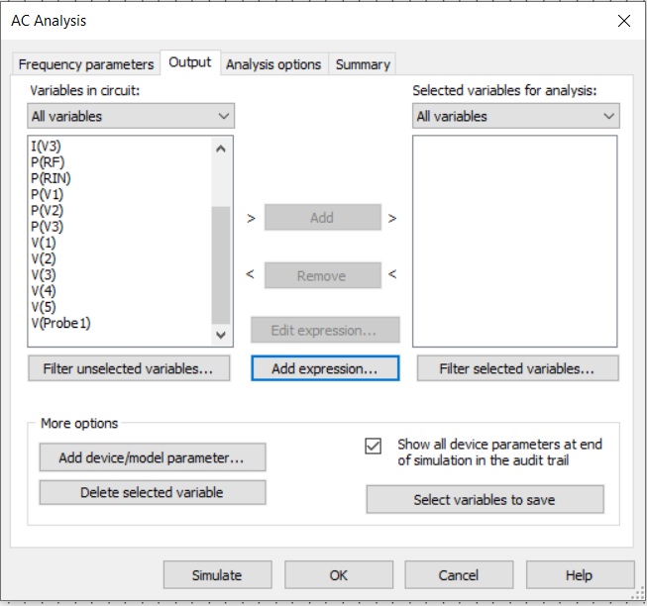
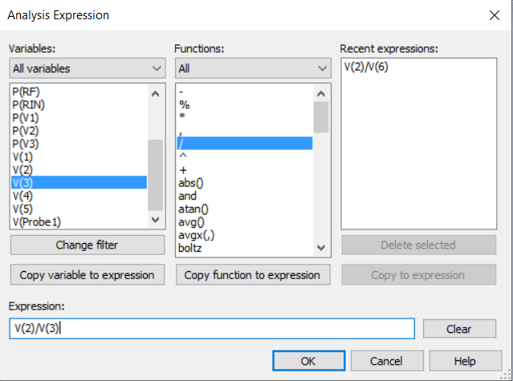

Multisim: Measure Gain
1. Click Simulate -> Analyses -> AC Analysis…
2. Select Output -> Add expression
3. Make sure you select $\frac{V_{OUT}}{V_{IN}}$-> OK -> Simulate
Note: $V_{OUT}$ is V(2) and $V_{IN}$ is V(3) in this case.

Slide 13
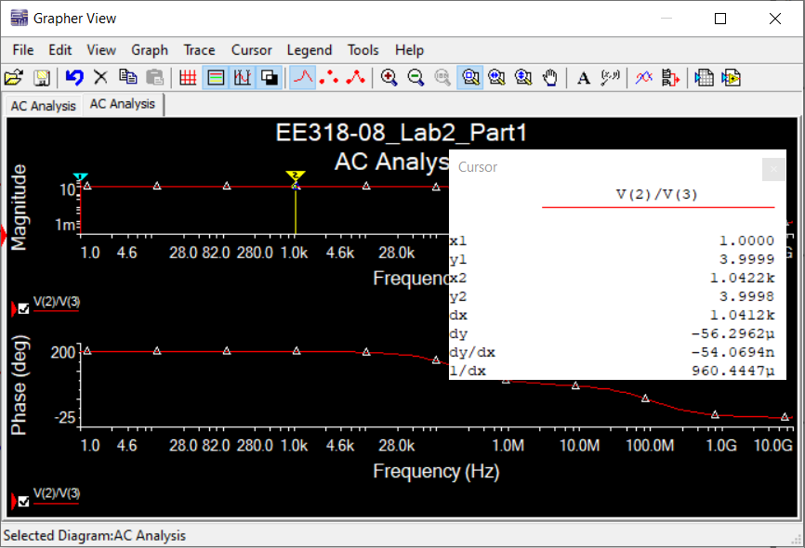
Multisim: Measure Gain (cont.)
4. Move Cursor to the desired location. In this case, when x is equal to 1 kHz, y is equal to 3.9998. Note: y is $\frac{V_{OUT}}{V_{IN}}$

Slide 14
Summary
Lab 2 Report & Pre-lab 3 are due on Tuesday 2nd February 2021 by midnight.
Analyze Fig. 2.2-2.3 and complete Table 2.1-2.2
Calculations
Simulation
Experimental results

